Slide 1
DSC 530 Final Project
By Michael Zoucha

Slide 2
Introduction
Inventory is the arguably the most important aspect of a sales business to manage, if you don’t have goods to sell you can’t sell them, but how much excess inventory is too much? Excess inventory, first and foremost, reduces available cash flow for an organization (Gartenstein, 2019). Reduced cash flow can lead requiring loans to cover liabilities and pay interest on that loan, or it can eliminate the ability to take advantage of a capital-requiring opportunity. In recent times, during the uncertainty of the pandemic, reduced cash flow from excess inventory meant the difference between weathering the storm and closing for good (Lazar, 2020). Using machine learning, forecasting sales quantity amounts per item, per location can help give businesses the opportunity to ensure they have enough inventory for upcoming sales, all while reducing excess inventory and the costs associated with that excess.

Slide 3
Statistical Questions
Using historical sales data, can one predict the maximum inventory needed on hand for a particular item in a particular time period? (i.e., for May 2022 we will need 22 of item x, and in June of 2022 we will only need 17)
Combining the predictions of inventory needs with up-to-date manufacturing and/or delivery times, can one create a dynamically changing minimum inventory number for each item? (i.e., it’s the middle May of 2022 and we have 10 of item x left, we need to order 15 by May 22 to have the stock we need for June.)
Can one optimize the relationship between number of orders to a manufacturer (hence, shipping costs) and keeping the absolute minimum number of stock on hand? (i.e., Should we order 15 on May 22, or 5 on May 22 then 5 on June 2, etc.)
Can these predictions and optimizations be broken down to the region, district, state, or even city level? (i.e., West Coast needs 12 in May 2022, Midwest needs 5 for May 2022, etc.) (i.e., San Diego needs 5, Los Angeles needs 3, Chicago needs 2, etc.)
Can one build price modeling into the forecasting to ensure inventory is purchased at lowest possible average-per-unit price? (i.e., the price of item x is forecast to go up in July of 2022, is it more profitable to buy and hold excess inventory at a lower cost?)
Could acquiring regional warehouse capabilities help reduce excess inventory even further? (i.e., San Diego only needs 2 of item x in store, because if they really need it, more is 1 day shipping away)

Slide 4
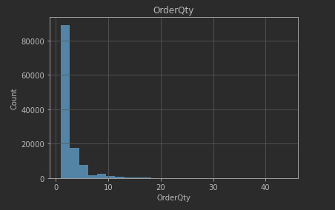
OrderQty - Number of items ordered per line
Min – 1
Max – 44
Mean – 2.266
Mode – 1
Median – 1
STD – 2.49
Variance – 6.21

Slide 5
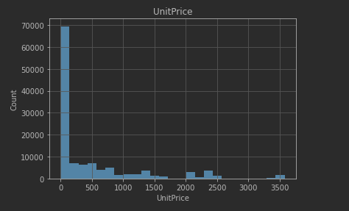
UnitPrice – Price per item for each line
Min – 1.32
Max – 3578.27
Mean – 465.09
Mode – 4.99
Median – 1
STD – 49.99
Variance – 565,331.17

Slide 6
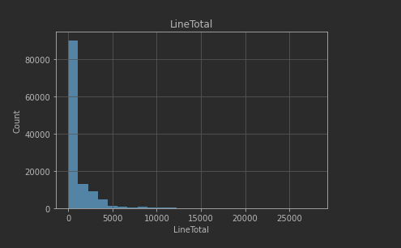
LineTotal – Line total (unitprice * orderqty)
Min – 1.37
Max – 27,893.62
Mean – 905.45
Mode – 4.99
Median – 134.98
STD – 1693.42
Variance – 286,7662.45

Slide 7
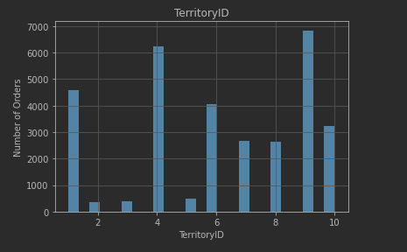
TerritoryID -
Number of orders by TerritoryID

Slide 8
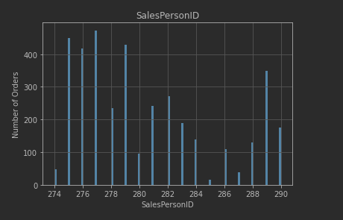
SalesPersonID -
Number of orders by SalesPersonID

Slide 9
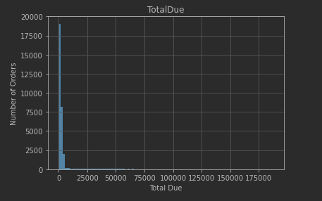
TotalDue -
Min – 1.52
Max – 18,7487.82
Mean – 3,916
Mode – 3,953.98
Median – 134.98
STD – 12,515.46
Variance – 156,636,806.92

Slide 10
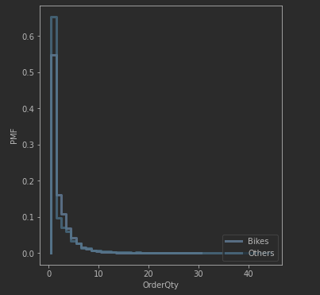
PMF
This PMF shows all items are generally ordered one at a time per order, but some bulk shopping does happen across all categories.
Taking this information, we can see that any forecasting model we build for one category / product ID should be well suited for all others.

Slide 11
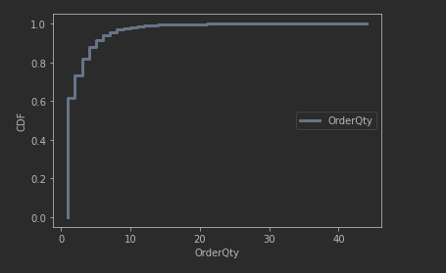
CDF
This CDF shows the distribution of number of items ordered per order, showing that the majority of orders only include 1-2 of each item.
We can use this to help predict inventory needs since there is not much bulk shopping happening.

Slide 12
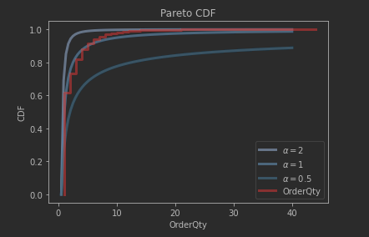
Pareto Distribution
The distribution of number of items ordered per item follows a Pareto distribution almost perfectly.
This helps us know we do not have to prepare for large orders when building a forecasting model.

Slide 13
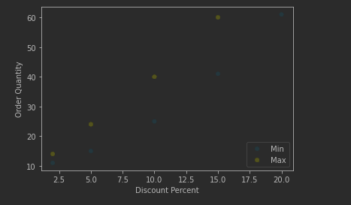
ScatterPlot #1
This shows the relationship between order quantity and discount percent
It is a positive correlation

Slide 14
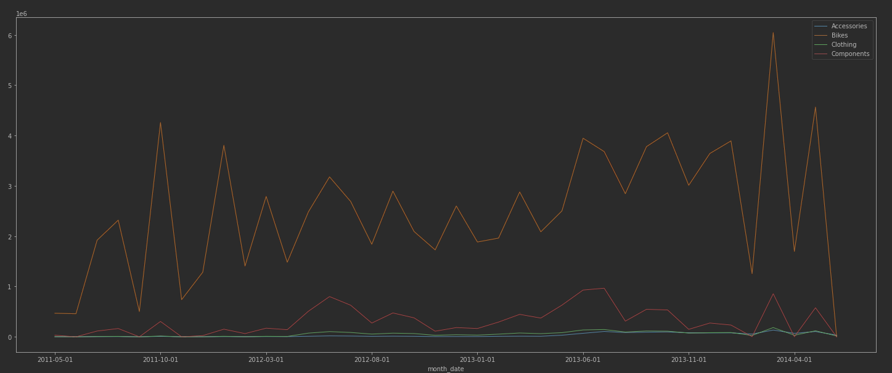
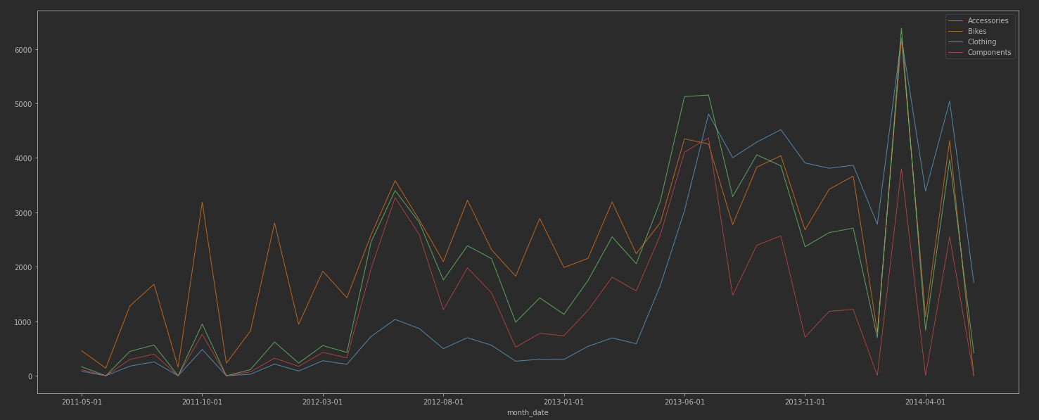
Time Series Analysis
Sales in dollars over time
Bikes are the source of significantly more revenue than all others
Number of items sold over time

Slide 15
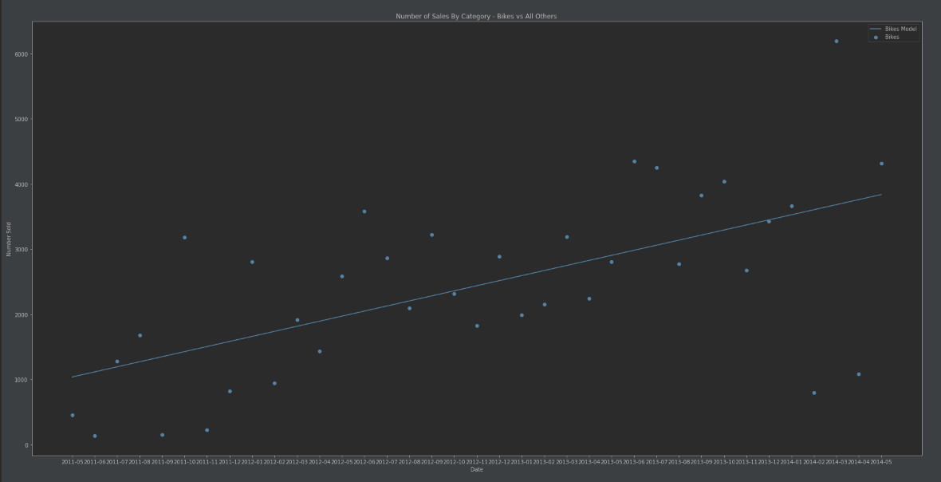
Linear Regression Model
Number of bike sales over time
Showing upward trend proving dynamic inventory control could prove very useful

Slide 16
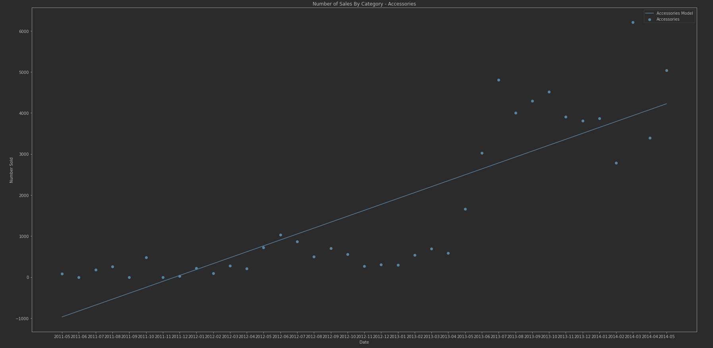
Linear Regression Model
Number of accessories sales over time
Showing upward trend proving dynamic inventory control could prove very useful

Slide 17
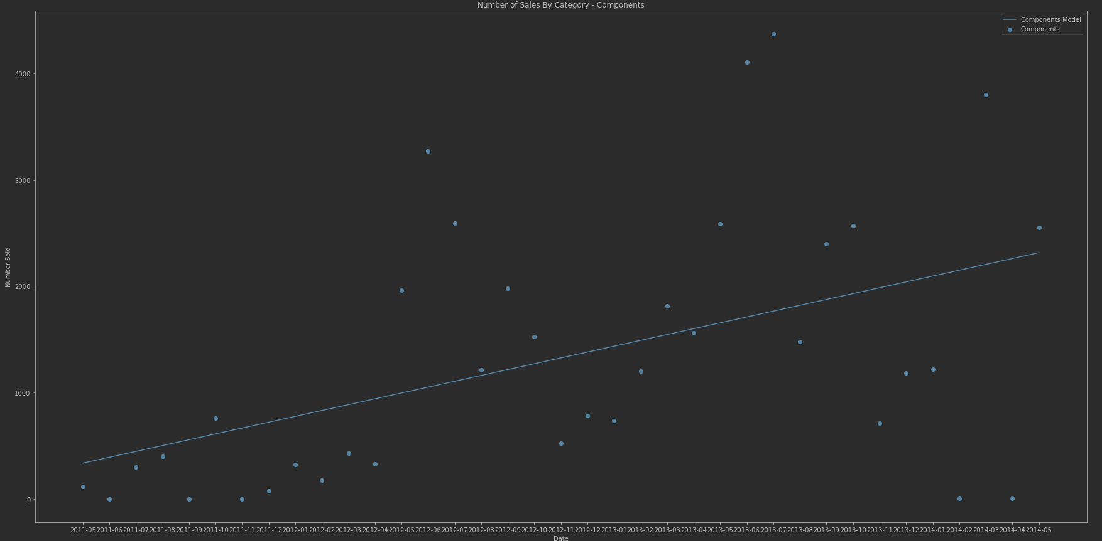
Linear Regression Model
Number of components sales over time
Showing upward trend proving dynamic inventory control could prove very useful

Slide 18
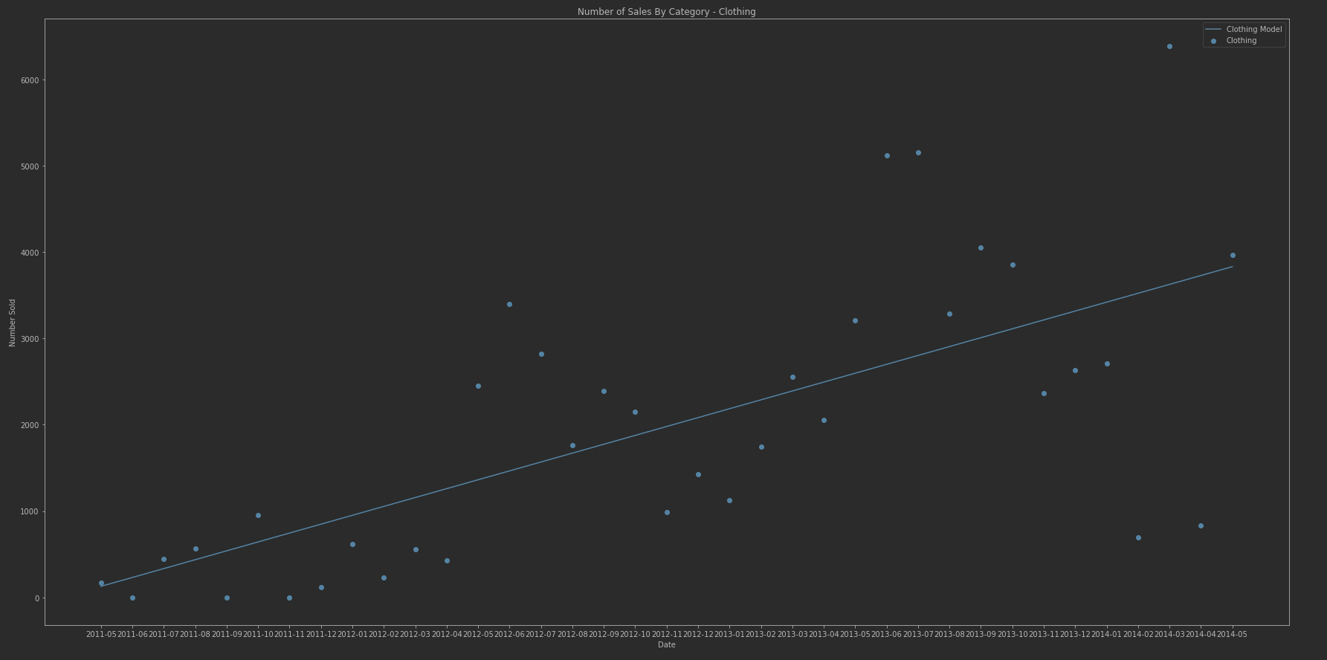
Linear Regression Model
Number of clothing sales over time
Showing upward trend proving dynamic inventory control could prove very useful

Slide 19
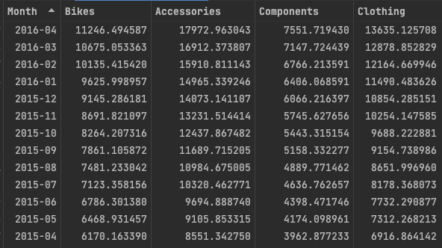

Results
Predictions
From the linear regression model that was completed, we can see that the monthly need for Bikes, Accessories, and Clothing will outgrow the current inventory levels beginning in January of 2016
This is assuming items are ordered at most once a month
Clothing outgrew the inventory requirements in May of 2012 and has continued to exceed ever since
The components category has significantly greater inventory levels than what are projected to be needed
This could leave room to cut down on inventory costs and free up cash flow.
Current Inventory Need Levels

